Slide 1
The Art and Science of Persuasive Writing
Presented by:
Jan Stork
Regional Director
Make-A-Wish® Greater PA & Southern WV

Slide 2
Today’s Objectives
Develop an awareness of audience personality type and strategies for customizing your writing to appeal to each audience.
Refresh and strengthen knowledge of basic writing skills.
Develop a greater understanding of the differences between writing with a fundraising purpose versus writing with a marketing purpose.
Be inspired to write with renewed creativity and “break out of the mold.”
Active participation; be comfortable asking questions as they arise.

Slide 3
“Writing comes more easily if you have something to say.”
-Sholem Asch

Slide 4
What are some time-honored “rules” of fundraising writing that you have been taught, that you were told must always be followed, that you consistently put into practice with your appeals and acknowledgement letters?

Slide 5
Today, we will challenge some of these rules.
Hopefully,
tomorrow you will begin to break some of them.

Slide 6
Rules NOT to be challenged
Your writing must be clear and easy to understand.
Your writing must be unified and well organized.
Your writing must be grammatically acceptable.
Your writing must have no spelling errors.
You must have at least one other person proofread your writing.
You must articulate your call to action.
Your writing must never compromise professional ethics.
You must know your audience.

Slide 7
Who is your fundraising audience?
NOT the general public! Identify your specific target audience.
Four Personalities
The Expressives
Like bold statements, new directions, initiatives, bright ideas; they want to learn about the exciting things you’re up to and they are easily bored.
The Analyticals
Crave facts, welcome documentation, statistics and testimonials; they need proof and have trouble deciding.
The Bottom-liners
Value brevity and like summaries; they want to be told their task and they make quick decisions.
The Amiables
Value relationships above all and want to be your friend and family; they respond to heavy use of “you” and warmhearted pictures.
Source: Tom Ahern, AhernInk: How to Build the Perfect Donor Newsletter

Slide 8
The Power of Persuasive Copy
Copy That Gets Results
Call To Action
Knowing Your Reader
Message
Clarity

Slide 9
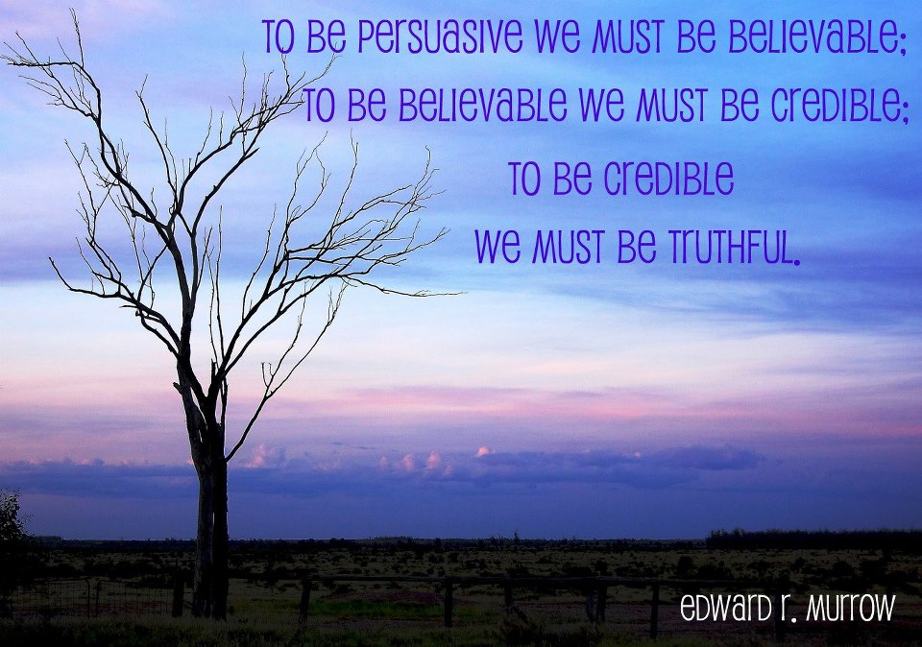

Slide 10
Writing not only comes easier when we have something to say,
Writing becomes better when what we have to say is:
True, compelling and meaningful.
The Message Matters!

Slide 11
The Message Matters
… and so does our purpose for saying it!
Marketing
Fundraising
Present information
Organization-centered
Use passive voice
Minimize emotion, but escalate positive
Keep large group/mass public audience in mind
Discuss what has already been accomplished
More common language, common word choice
Tell a story
Donor-centered
Emotional
Personal
About a specific project, program, service
Set a specific goal - what you want to accomplish
Specific call to action
Fresh language, word choice

Slide 12
Before-and-After Example #1
Please fund our prison literacy program.
Family Ties Organization has designed a powerful program to serve children of prison inmates and their families by creating on-site libraries in prison visiting rooms, giving books for children to take home and keep, supporting prisons’ Storybook Programs, and offering literacy seminars for prisoners and their children to help them read and spend time together.

Slide 13
Please fund our prison literacy program.
Family Ties Organization has designed a powerful program to serve children of prison inmates and their families by creating on-site libraries in prison visiting rooms, giving books for children to take home and keep, supporting prisons’ Storybook Programs, and offering literacy seminars for prisoners and their children to help them read and spend time together.
What do you think of this appeal? What’s wrong with it?

Slide 14
Family Ties Organization has designed a powerful program to serve children of prison inmates and their families by creating on-site libraries in prison visiting rooms, giving books for children to take home and keep, supporting prisons’ Storybook Programs, and offering literacy seminars for prisoners and their children to help them read and spend time together.
It uses passive voice
It’s about the organization and its program, not the results (which is what the donor cares about).
The sentence is way too long.
The word “powerful” is common and, in this case, meaningless.

Slide 15
Let’s rewrite it…
Let’s make it better…
Your gifts help to strengthen the estranged family bonds between prisoners and the children they rarely see. The books and libraries you fund are important. But most of all, you are helping to foster much-needed family time, care and attention – not only for the inmates, but for the children who need their love so very much.
Source: Gail Perry, Fired-Up Fundraising: Crafting Fundraising Letters: What to Say Instead of “Programs and Services”

Slide 16
Before-and-After Example #2
On behalf of Veteran’s Society, thank you for your recent gift of $250, which we received on June 5, 2012. As required by the IRS, we confirm that you have received no goods or services in exchange for your contribution. The Veteran’s Society will make good use of your gift to support our programs and services, delivering the greatest impact possible. Thank you again.
What do you think of this acknowledgement? What’s wrong with it?

Slide 17
On behalf of Veteran’s Society, thank you for your recent gift of $50, which we received on June 5, 2012. As required by the IRS, we confirm that you have received no goods or services in exchange for your contribution. The Veteran’s Society will make good use of your gift to support our programs and services, delivering the greatest impact possible. Thank you again.
BORING (not compelling or meaningful)
What programs and services?
Not personal or emotional
Common, overused language
Organization-centered

Slide 18
Let’s make it better…
Just this week, Tom, who recently returned from his third tour of duty in Afghanistan, had a breakthrough. And it is because of you and your generosity that we’re able to offer Tom, and so many others like him, the counseling they so desperately need.
Tom, feeling alone and depressed when we first met him, has struggled with how to feel normal again. He has felt like a stranger to his family and friends. But with help from a specially-trained therapist , Tom is now feeling positive about himself and his future. And his wife and children have said that the old Tom is back, and their future looks bright!
On behalf of the Veteran’s Society, thank you for your generous gift of $250, which we received on June 5, 2012. As required by the IRS, we confirm that you have received no goods or services in exchange for your contribution.
NOTE: The appeal letter asked for donations to help hire additional therapists to meet the needs of the veterans returning from war zones, who were struggling to acclimate back into society.

Slide 19
Samples of some of our most successful proposals…

Slide 20
Dear Mr. Donor:
A wish come true. It’s something you read about in fairytales featuring genies, wizards and magicians. Stories that start with “once upon a time” and end with “happily ever after.” But the truth is a very real thing. And it’s something we can bring to life for children who need it most.
It all started “once upon a time,” 25 years ago, when a child in our area living with a life-threatening medical condition made a wish. He wanted to visit his uncle in Texas for a simple piggyback ride. The Make-A-Wish Foundation of Greater Pennsylvania and Southern West Virginia made that wish come true.
Since that day, we have made more than 9,500 wishes come true. Last year alone we granted 707 wishes – nearly 2 wishes a day. And we’ve never had to turn down a single wish. That’s pretty incredible knowing the average wish costs $3,400.
But without the generosity of donors like you, none of this would be possible. Your contribution makes such a difference. Last year you were kind enough to make a $3,400 Wishmaker grant to completely fund the wish of a York child. We truly appreciate that and we hope you’re willing to make the same donation this year.
Wishes do come true. So you see, it doesn’t take a magic wand. It doesn’t take an enchanted spell or even a fairy godmother. Making a wish come true just takes people like you. With your continued support, we’ll create many more “happily ever after” moments for children in York.
Thank you for your generosity and support. Thank you for making a difference.

Slide 21
Dear Mr. Foundation:
In fiscal year 2005, the Make-A-Wish Foundation of Western Pennsylvania and Southern West Virginia fulfilled the magical wishes of 608 children – the most wishes ever granted in our chapter’s 22-year history. A wish dad recently wrote a letter that truly touched us, and reinforces the importance of why our donors choose to share the power of a wish®.
“We all know that children dream. It is one of the things they do best. Our own childhood was filled with somedays. When a child becomes seriously ill, those somedays still exist, but they are touched with a bit more desperation and anxiousness. They are living their lives being poked, prodded and in pain, and it becomes very real that those somedays might not happen. Make-A-Wish provides these children with the real hope that at least one of their somedays can happen. It accelerates this one aspect of their life without putting a burden on the family to provide it. Instead, this burden is shared by the unselfish giving of untold numbers of people. It is amazing that all of these people give without knowing the individuals they are helping!”
Of the 608 somedays that came true last year, Elise was able to meet all of her favorite princesses at Disney World; Ashley received the break she needed from her cancer treatments while on a Caribbean cruise; and Heather met her idol, Katie Couric. Our children’s wishes are as creative and unique as they are.
Make-A-Wish wants to be able to continue to encourage the more than 400 children who are waiting for wishes today. We invite you to again help us provide hope, strength and joy to these children and their families with a gift of $3,900, to make an Erie County wish child’s someday come true.
I want to thank you for considering this request, and for helping somedays come true for so many children in the past. We agree with our wish dad – you are amazing!

Slide 22
Your proposal resulted in a generous gift, now how do you ensure that your thank you has the potential to lead to another gift?

Slide 23
Tips for Creative Thank You Letters
Start with a story about how donors’ money will be used – you don’t always have to start with “Thank you for your gift of…,” but be sure to include it elsewhere in the letter.
Relate the thank you letter back to the appeal letter (e.g., if you asked for money to build a rec center, talk about the rec center).
Use a photo to demonstrate how donors’ money was used (a smiling child, a rendering of a building, a student studying in the library, etc.).
Include invitations to tours, upcoming celebrations, as appropriate. Be careful of value.
Use a quote from someone touched by your organization. Be careful not to overuse quotes from “experts” or “scholars.”

Slide 27
We make a living by what we get, but we make a life by what we give.”
Winston Churchill

Slide 28
Put It Into Practice - Activity
In small groups, use the statement below as a starting point for a fundraising appeal – rewrite it, revise it, and add to it applying what we’ve been discussing today.
Each group will be determine their audience, whether it be a single or combination of personality types (expressive, analytical, bottom-liner, amiable).
One person from each group will be a spokesperson and share with us all your group’s writing.
With your gift, generations of students at XYZ University will have the resources necessary for research.

Slide 29
With your gift, generations of students at XYZ University will have the resources necessary for research.
Four Personalities – To Whom Are You Catering?
The Expressives
Like bold statements, new directions, initiatives, bright ideas; they want to learn about the exciting things you’re up to and they are easily bored.
The Analyticals
Crave facts, welcome documentation, statistics and testimonials; they need proof and have trouble deciding.
The Bottom-liners
Value brevity and like summaries; they want to be told their task and they make quick decisions.
The Amiables
Value relationships above all and want to be your friend and family; they respond to heavy use of “you” and warmhearted pictures.
Source: Tom Ahern, AhernInk: How to Build the Perfect Donor Newsletter

Slide 30
Don’t tell me the moon is shining: show me the glint on the broken glass.
-Anton Chekhov
I’m not a very good writer, but I’m an excellent rewriter.
-James Michener

Slide 31
References and Resources
AhernInk: How to Build the Perfect Donor Newsletter: A checklist of stuff that really matters; Tom Ahern
Fought, Susie, Successful Direct Mail, Telephone & Online Fundraising: Spicing Up Your Thank-You.
Hairston, Maxine, Contemporary Composition, Fourth Edition, Houghton Mifflin Company, Boston.
Perry, Gail, MBA, CFRE, Fired-Up Fundraising: 2 Questions You’ve Got To Answer in Your Year-End Appeal Letter.
Perry, Gail, MBA, CFRE, Fired-Up Fundraising: Crafting Fundraising Letters: What to Say Instead of “Programs and Services.”
Warwick, Mal, Successful Direct Mail, Telephone & Online Fundraising: Writing Persuasive Copy.

Slide 32
Proofread carefully to see if you any words out.

Slide 33
Good Grammar Reference Books:
The Gregg Reference Manual by William A. Sabin
The Associated Press Style Guide
Jan E. Stork
Regional Director
Make-A-Wish® Greater Pennsylvania
and Southern West Virginia
814.868.9474
Jstork@wishworld.org

